Slide 1
Electrical Engineering
Day 2

Slide 2
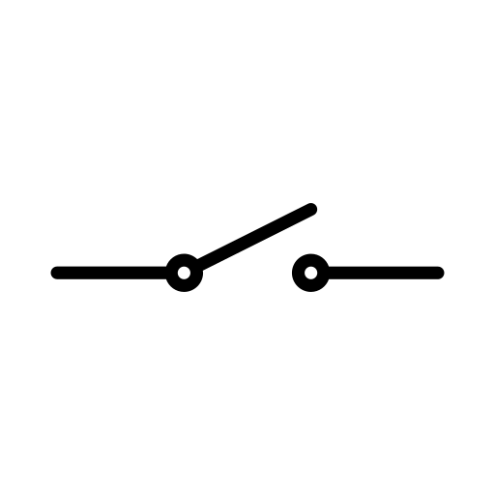
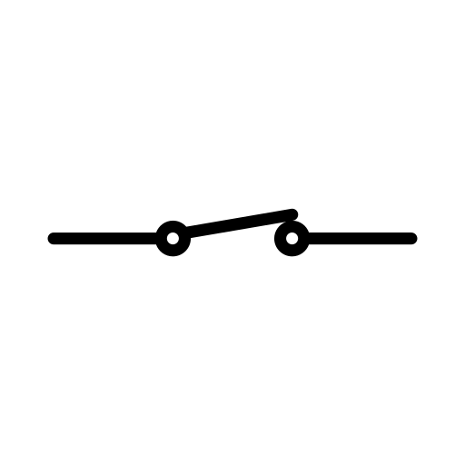
Components - Switch
A switch is a component that controls the flow of electricity. It can be on (closed) or off (open)
Closed switch – electricity can flow
Open switch – no electricity can flow

Slide 3
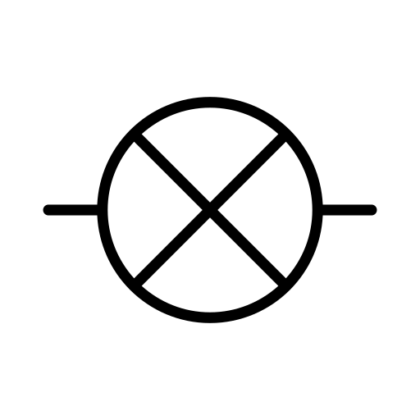
Components - Lamp
A lamp is also called a light bulb. The flow of electricity heats up a filament in the bulb, which causes it to light up. This symbol may also be used to depict a general load, which is any component that consumes power
off
on

Slide 4
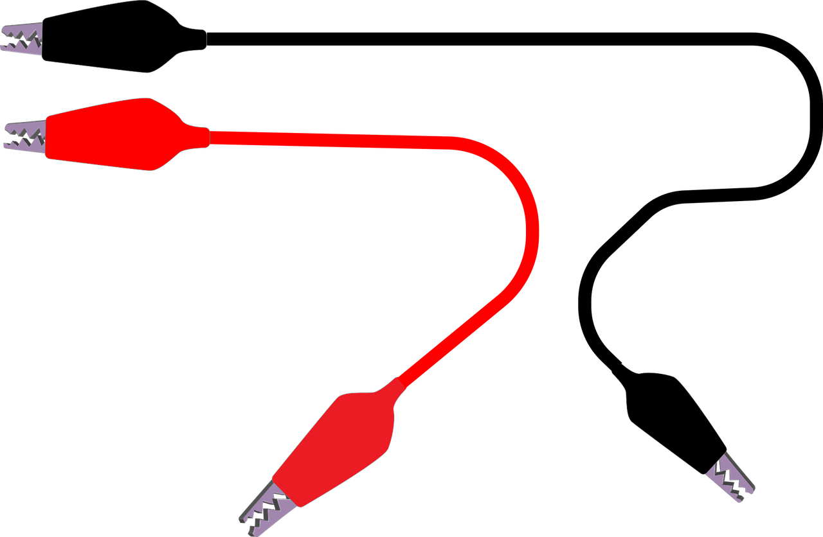
Components - WIRE
A wire is a long thin piece of metal that is used to carry electric current. Most wires often has an inner core made of a material that conduct electricity and an outer coating that is an insulator, often plastic.

Slide 5
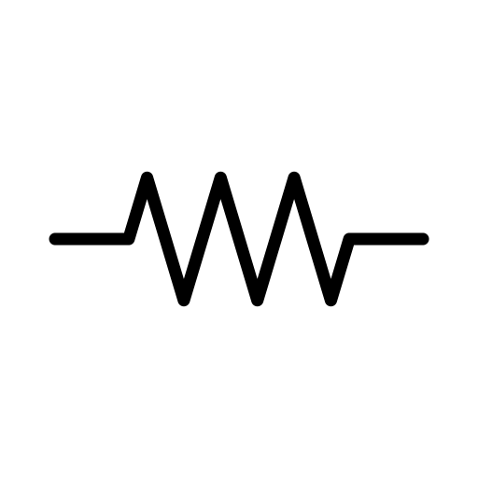
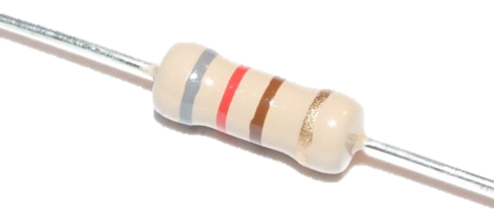
Components - Resistor
A resistor is a component that opposes the flow of energy. It restricts the current flowing through the circuit. Resistance is a material property, and every component has some resistance, but we use resistors when we need a specific amount of resistance.
Resistors lower voltage across an active circuit; the voltage on the positive end will be higher than the voltage on the negative end. The voltage across is a resistor is proportional to the current flowing through it.

Slide 6
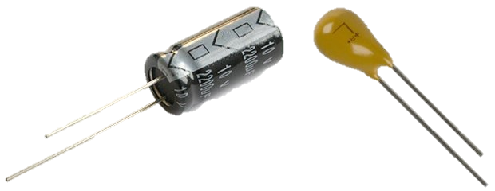
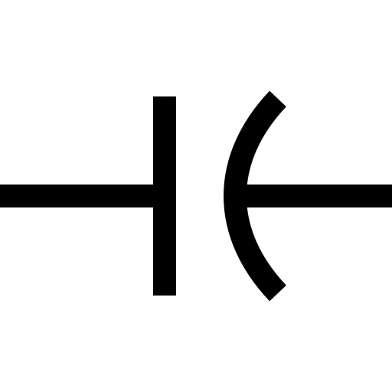
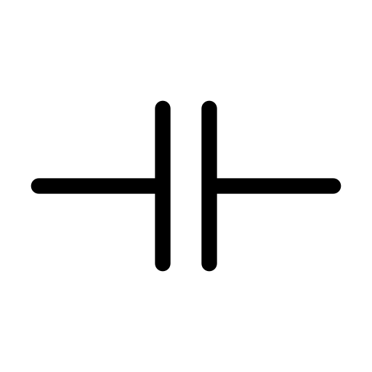
Components - Capacitor
A capacitor is a component that stores charge in an electric field. They are made up of two conductors separated by an insulator. Capacitors can be either polar, meaning they have to be wired in a specific direction, or non-polar, meaning they can be wired in either direction
polar
non-polar

Slide 7
Components - Capacitor
When a circuit first comes on, the charge in the capacitor begins to build. Electrons gathering on one end and vacating the other create a temporary current as they move. As they do so, the voltage across the capacitor increases and the current decreases. After the circuit has been on for a long time (steady-state), there is a voltage across the capacitor and no current through it. At steady-state conditions, a capacitor acts like a break in the circuit.
polar
non-polar

Slide 8
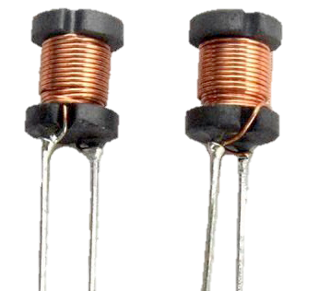
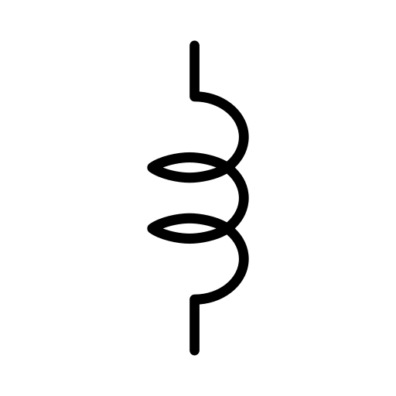
Components - Inductor
An inductor is a component that stores energy in a magnetic field. It is usually made of coiled wire, which develops a magnetic field as current flows through it. This field resists and slows the movement of electrons in the inductor.

Slide 9
Components - Inductor
When a circuit first comes on, the voltage across an inductor is high and no current flows through it. Over time, the voltage drops and the current through the inductor increases as the magnetic field develops. At steady-state conditions, there is no voltage across an inductor and current flows through at a constant rate. An inductor behaves like wire at steady-state.

Slide 10
Components – Capacitors vs Inductors
It may be helpful to think about these in terms of their behavior cycles.
 | Circuit has just turned on | Circuit has come on recently | Steady state
Capacitor | Capacitor has no voltage and current flows freely | Voltage increases, current decreases, electric field forms | Capacitor has a voltage and no current flows across (break)
Inductor | Inductor has a voltage and no current flows across | Voltage decreases, current increases, magnetic field forms | Inductor has no voltage and current flows freely (wire)

Slide 11
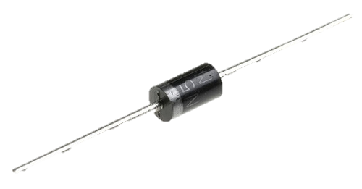
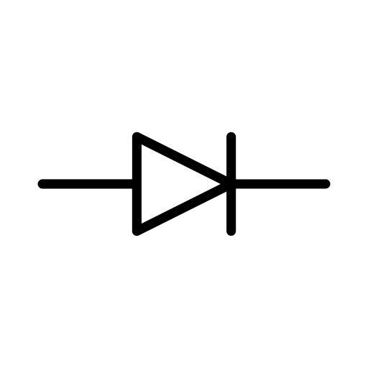
Components - DIODE
A diode is a circuit element which essentially is a resistor with polarity; it has a different resistance in one direction than in the other. Most diodes have no resistance in one direction and very high resistance in the other, so that they only allow current to flow in one direction.
The symbol for a diode looks like an arrow that points in the direction of current flow. The diode shown above would allow current to flow from left to right.

Slide 12
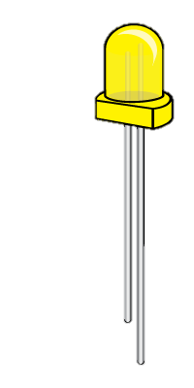
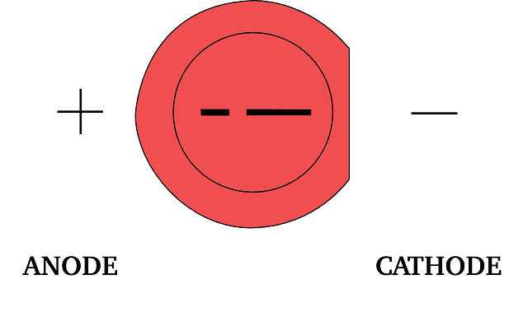
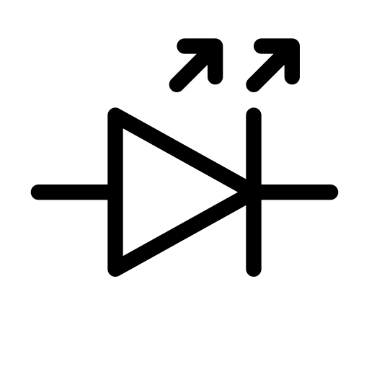
Components - LED
An LED is a light-emitting diode. Just like other diodes, it is polar and must be wired in the correct direction in order to light up.
Short side
-
Long side
+

Slide 13
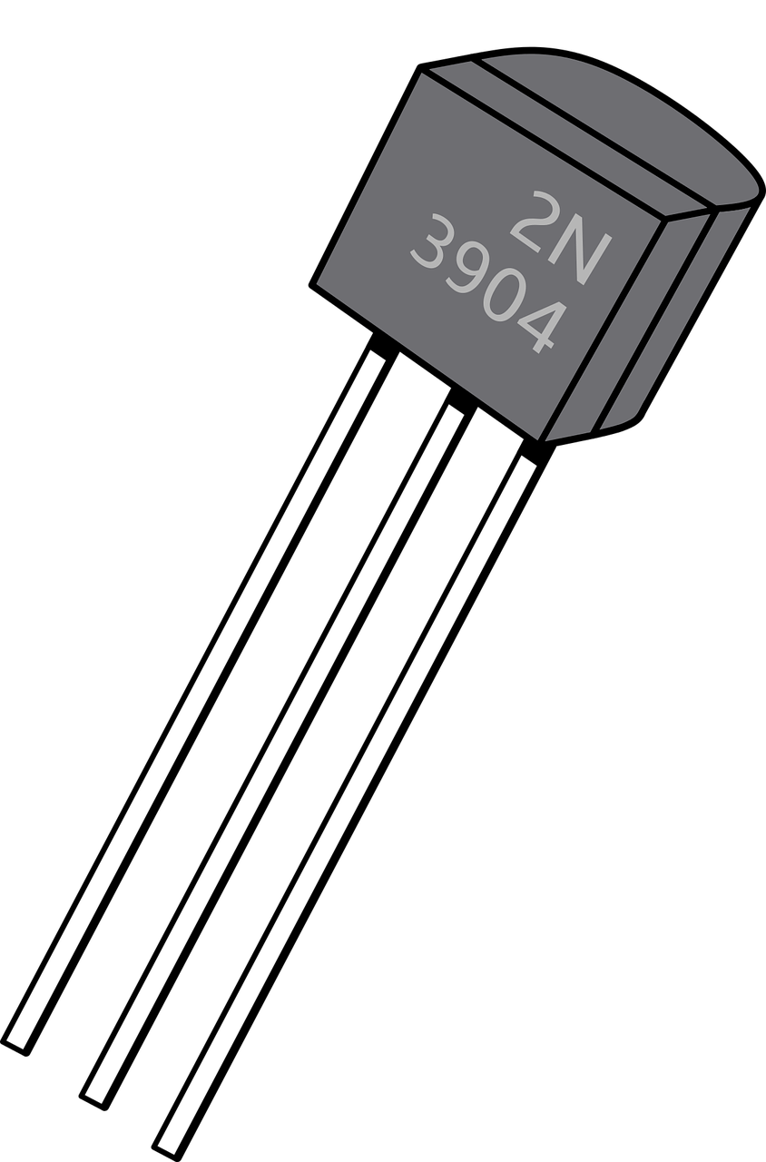
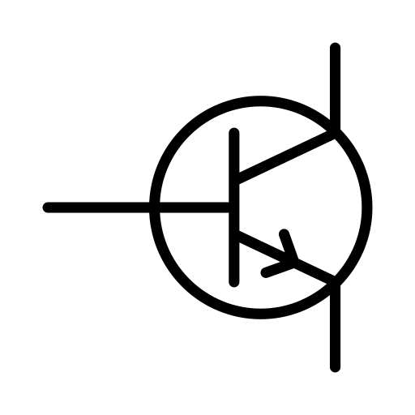
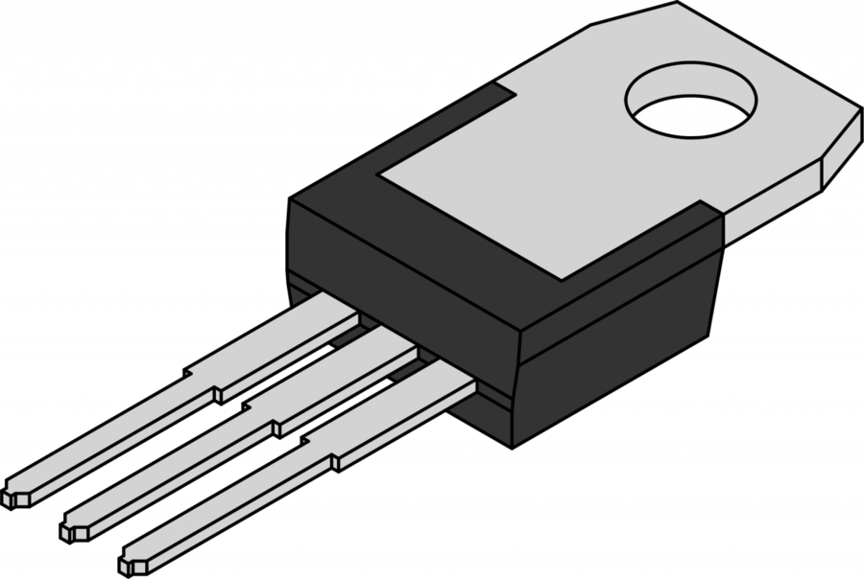
Components - transistor
Transistors are circuit components made of semiconductors that amplify and switch currents.

Slide 14
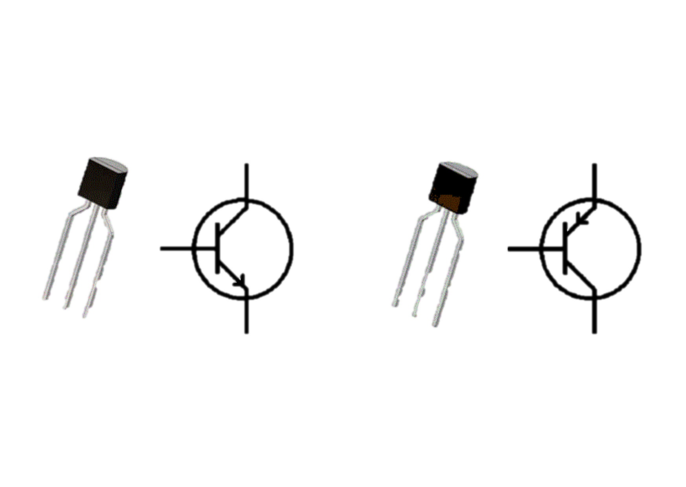
Components - transistor
The terminal that receives current is called the collector. The terminal that releases current is called the emitter. The terminal that controls whether the transistor is on is called the base. They may change depending on the type of transistor.
NPN transistor
PNP transistor
C
E
B
B
B
C
E
B
C
E
E
C

Slide 15
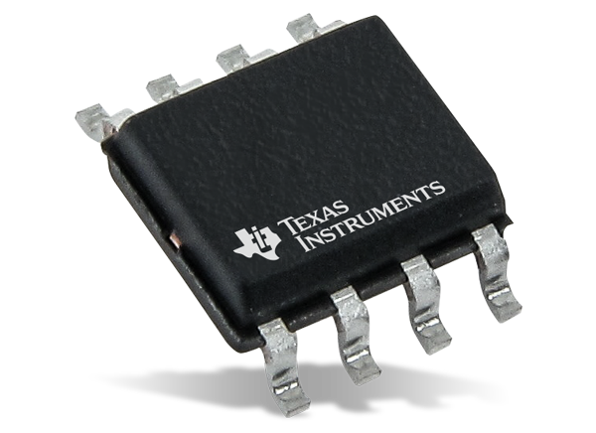
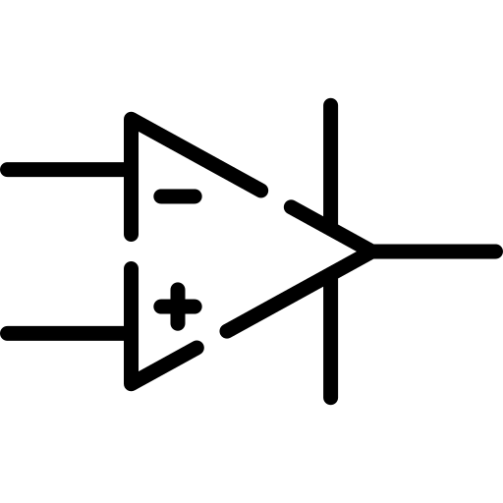
Components – Op-AMP
An operational amplifier (op-amp) is an integrated circuit (IC) that amplifies the difference in voltage between two inputs.
in
out
in

Slide 16
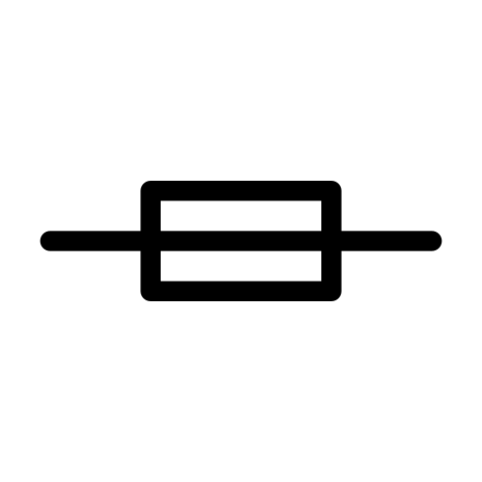
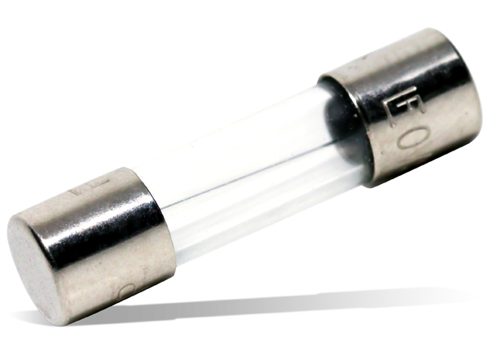
Components – Fuse
A fuse is an electrical safety device that operates to provide overcurrent protection of an electrical circuit. Its essential component is a metal wire or strip that melts when too much current flows through it, thereby stopping or interrupting the current.

Slide 17
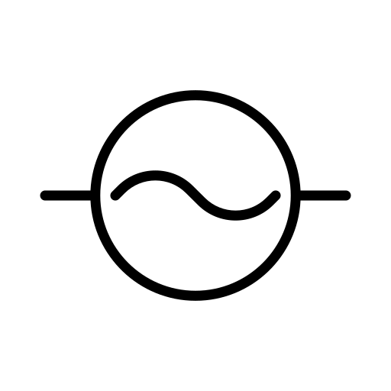
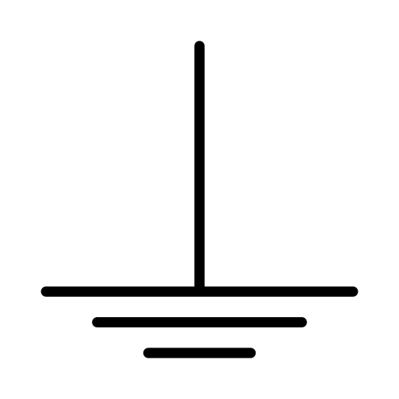
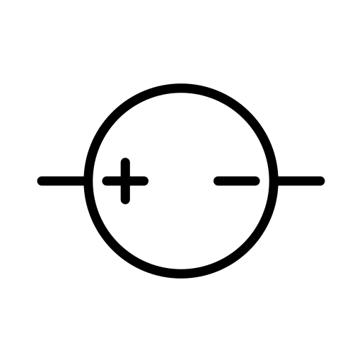
Components – Power
An operational amplifier (op-amp) is an integrated circuit (IC) that amplifies the difference in voltage between two inputs.
Voltage source
AC power source
Ground
3.3V
DC power source
+
-

Slide 18
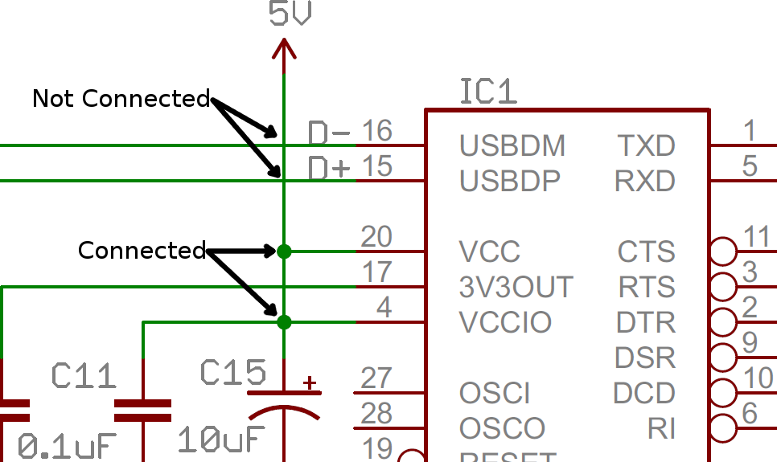
Schematics – nodes and junctions

Slide 19
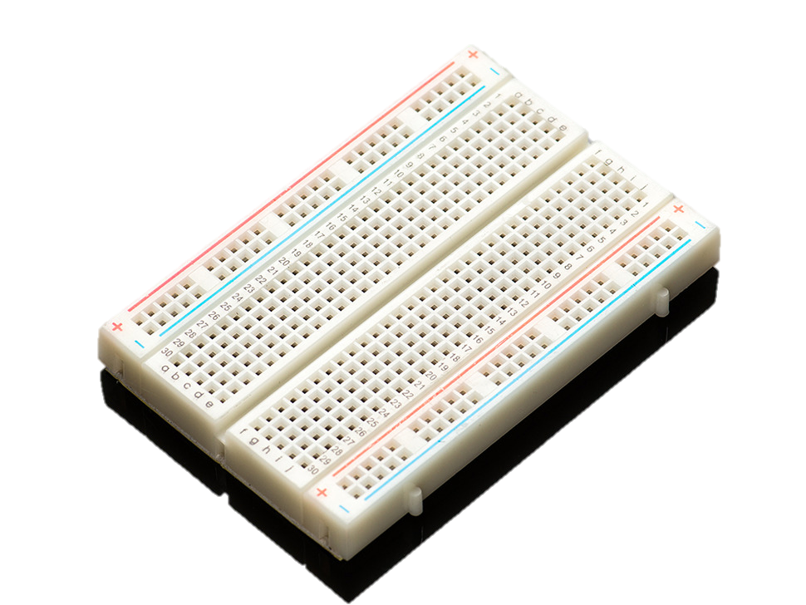
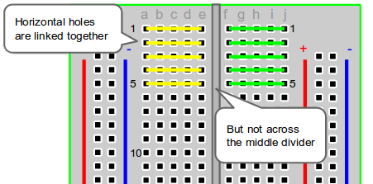
Breadboards

Slide 20

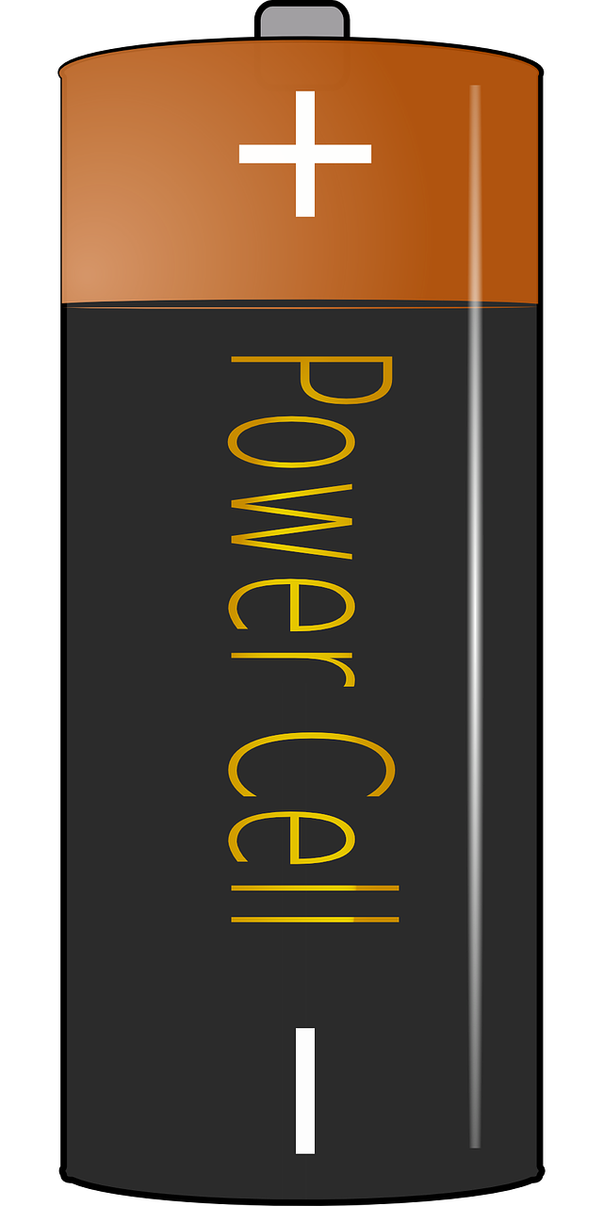
Series circuit
If a bulb is removed the circuit will be broken, and the electrons stop flowing.
The current flows the same, from one component to another.
When you plug in that second, third bulb, they will become equally dim. More resistance has been added to the circuit, which decreases the flow of current, as the battery has more work to do.

Slide 21
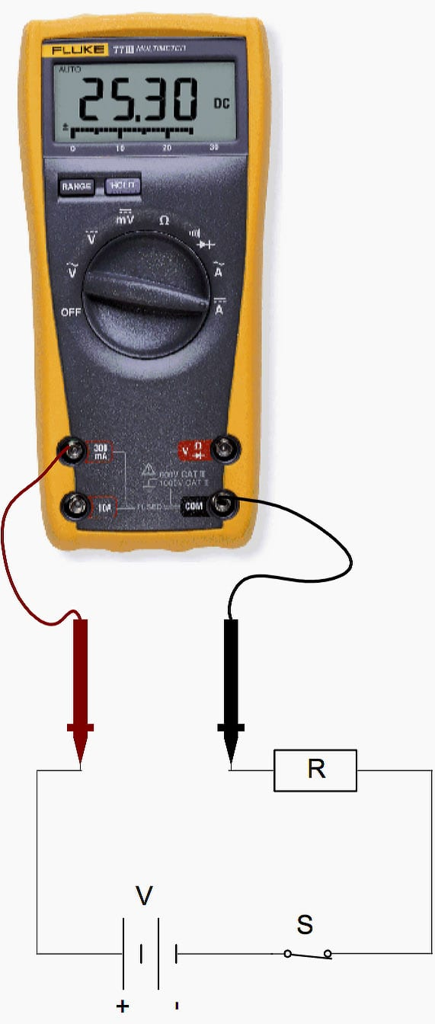
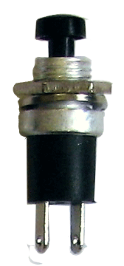
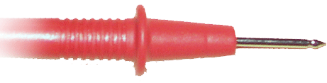
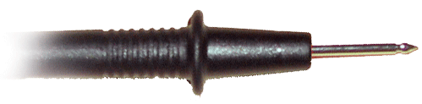

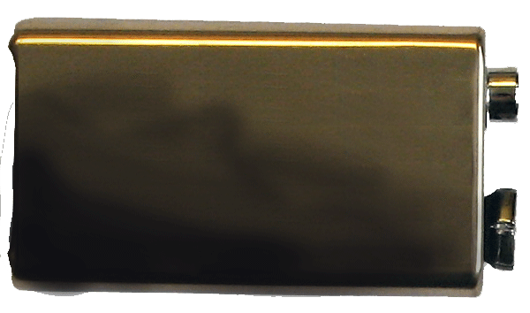
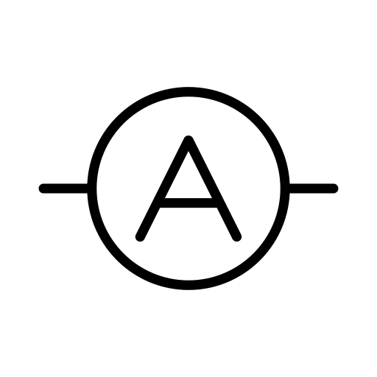
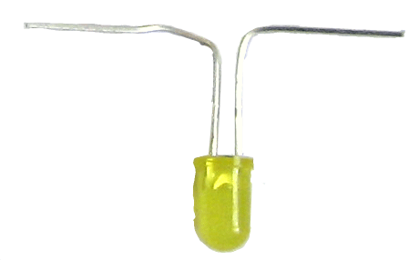
Measuring Current
Current is measured in series through a component
Switch
Battery
Resistor
Light

Slide 22
Parallel circuit
In a parallel circuit the bulbs will remain bright, but it will drain the battery power quicker.
Components connected in parallel are connected along multiple paths so that the current can split
up; the same voltage is applied to each component.
If a bulb is removed the electrons will continue to flow, as each bulb has its own circuit.

Slide 23
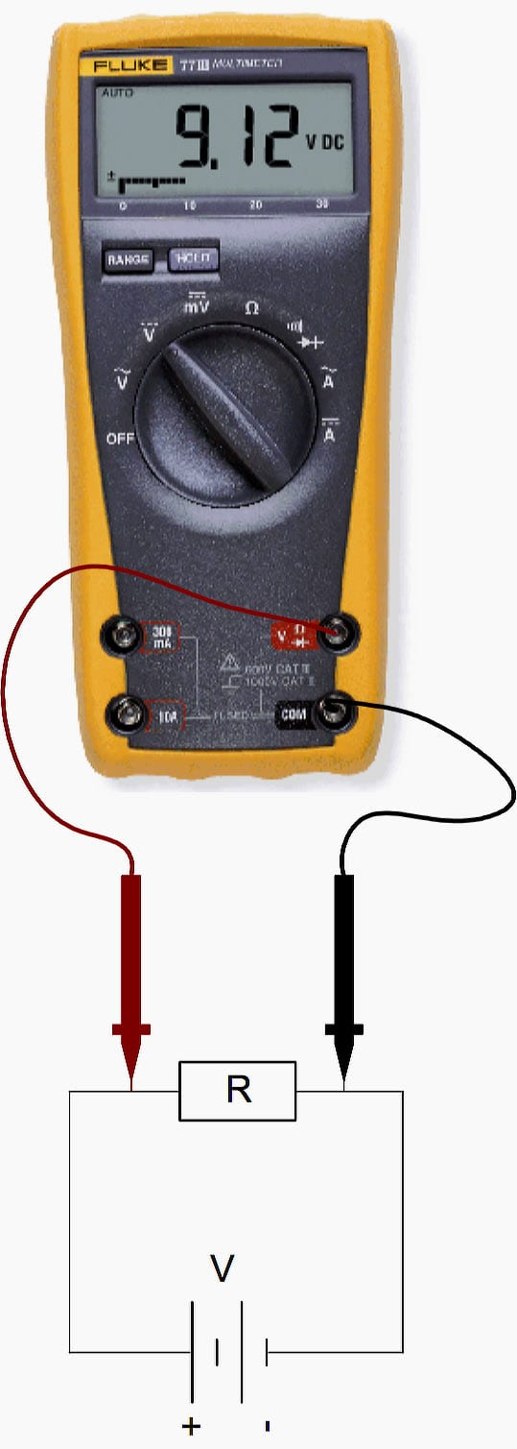
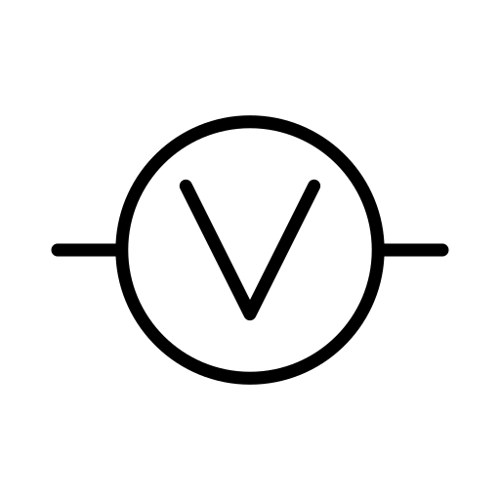
Measuring Voltage
Voltage is measured in parallel across a component
Switch
Battery
Resistor
Light

Slide 24

Components

